Slide 1
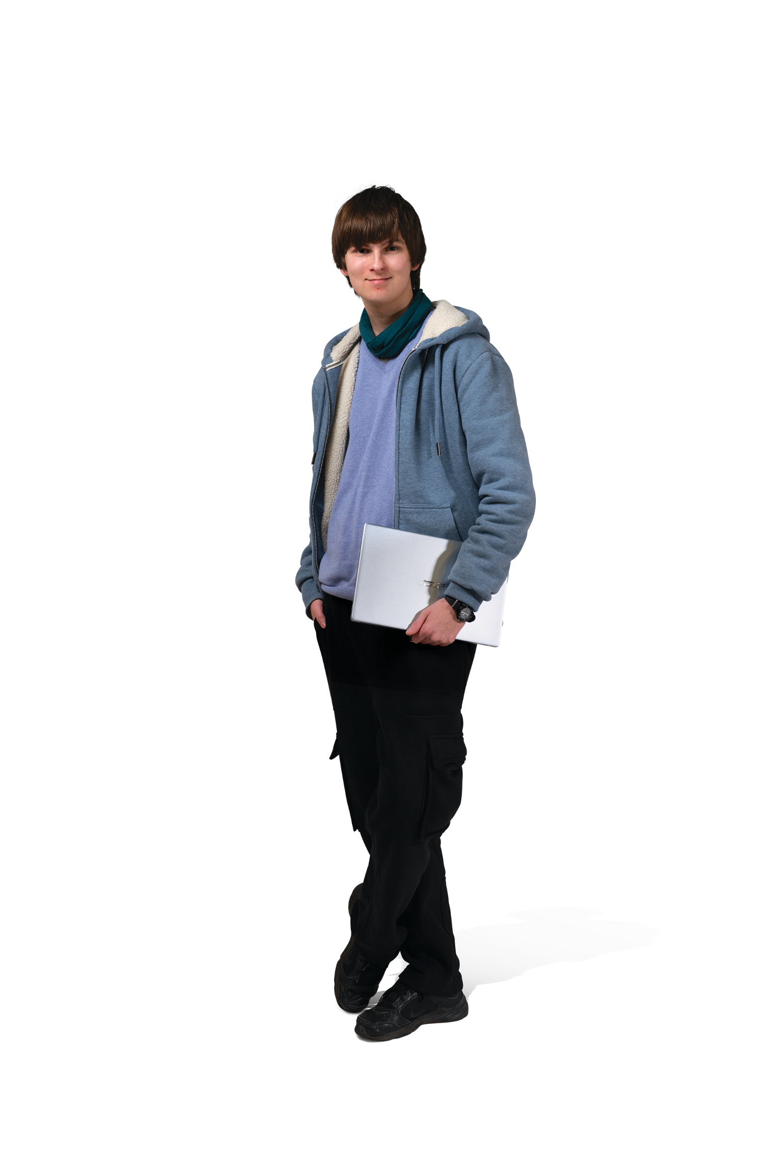



Year 10
Taster Day
2026
Peter Symonds College

Slide 2

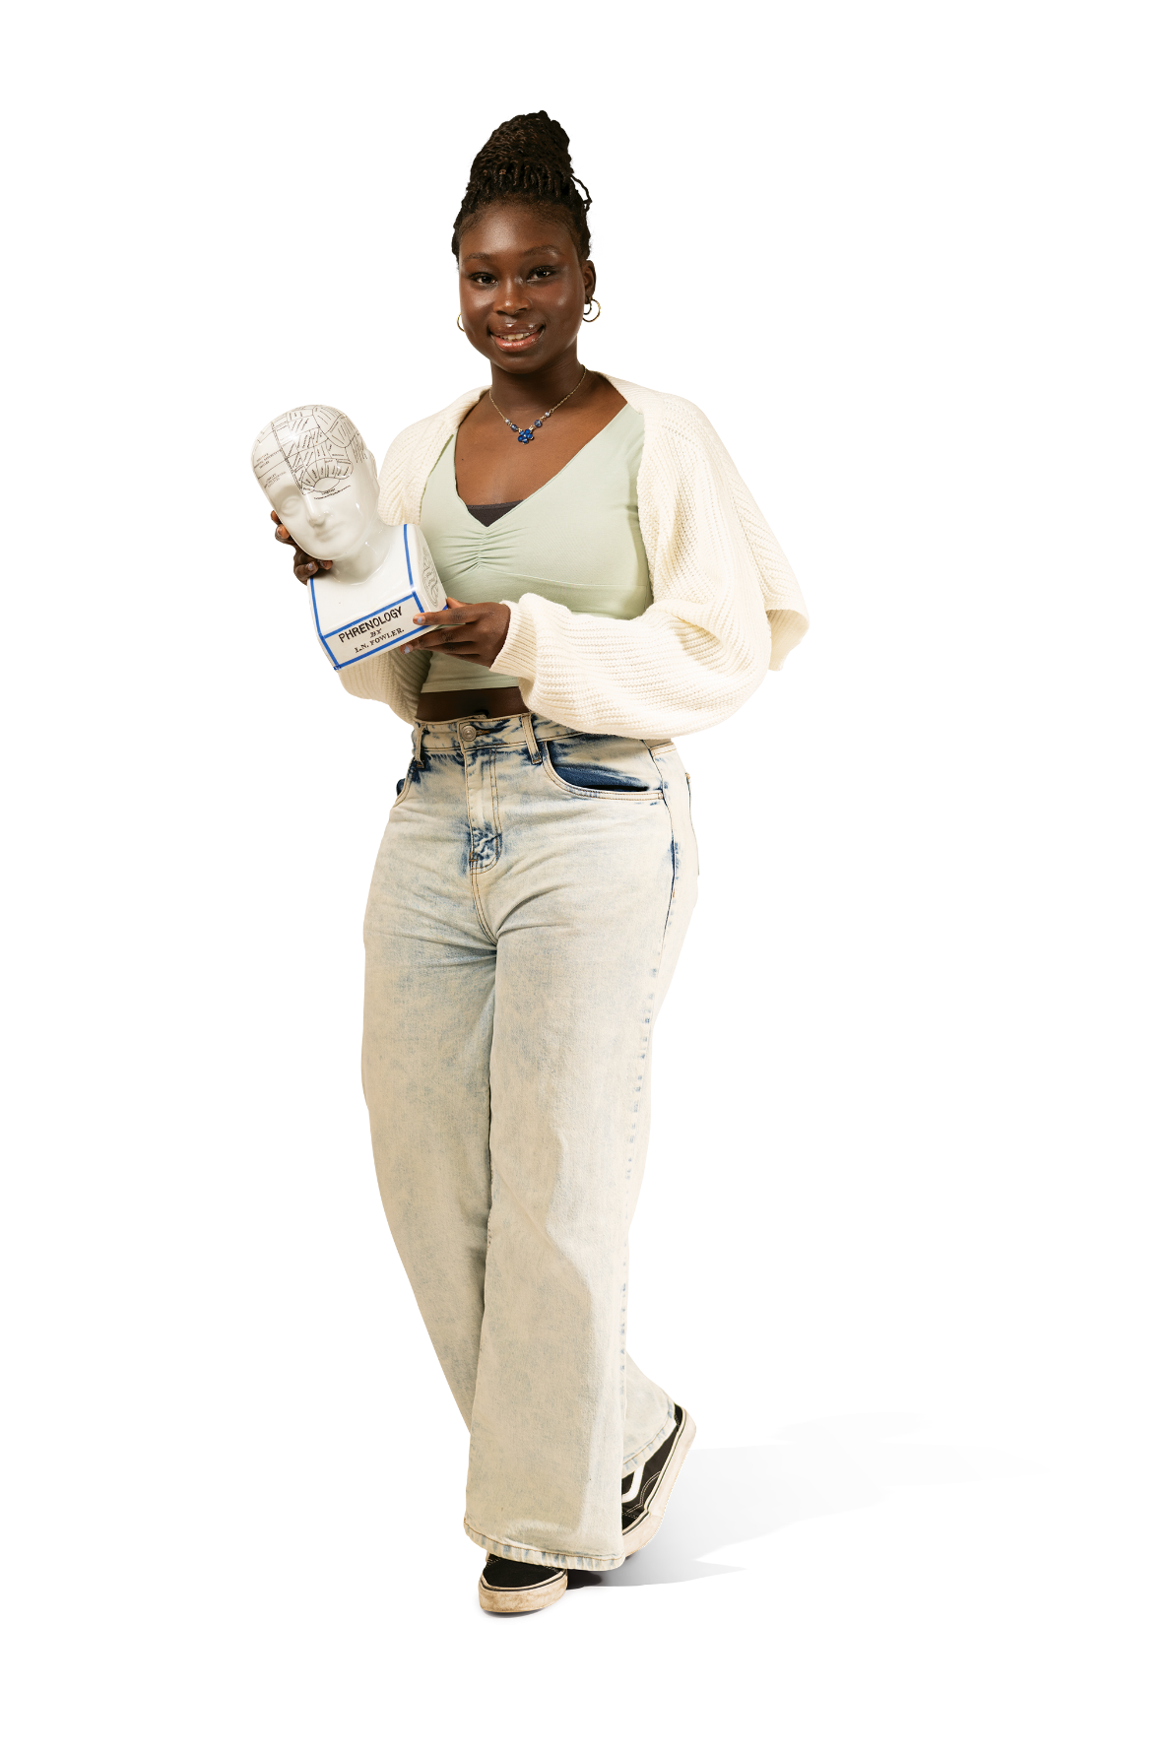
Year 10 Taster Days
23 June 2026
What is a Taster Day?
Your chance to find out what it’s like to be at Peter Symonds
Get a feel for the difference between school and college
Have a go at new/different subjects, perhaps ones that your school doesn’t offer
There will also be Open Evenings on 1& 2 July which you can attend

Slide 3
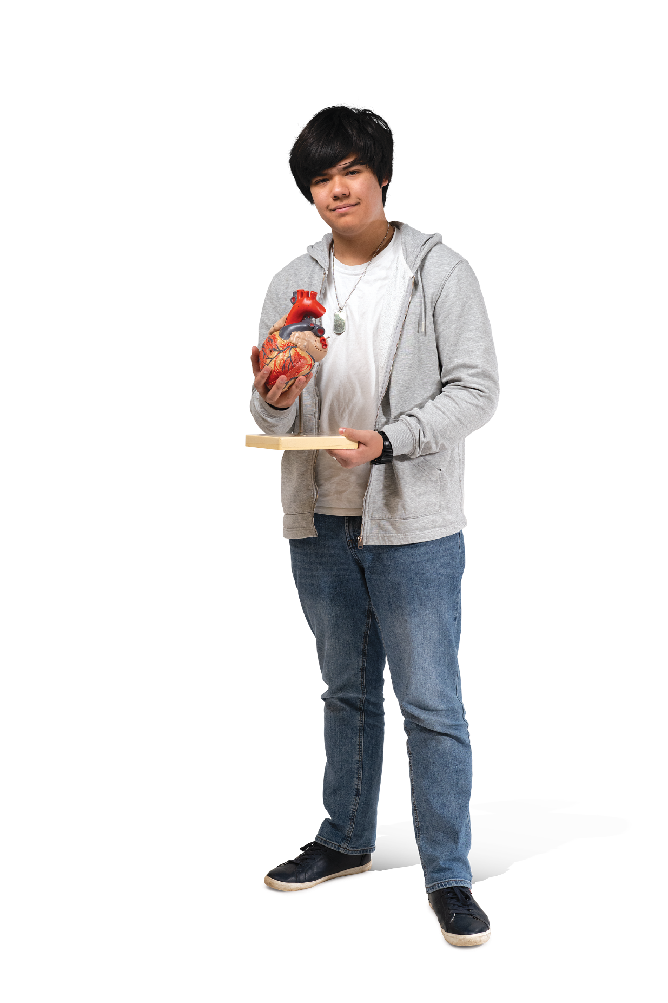
Year 10 Taster Days
June 2026
What to expect
The style of your lessons will be different to school
It is a normal college day, so PSC students will also be on campus
All Year 10 students MUST wear school uniform

Slide 4

Year 10 Taster Days
June 2026
What will you be doing?
The day will start with a welcome tutorial and registration
You will be able to do four taster sessions – there are loads of
subjects to choose from!
We’ll provide you with a voucher for lunch, but you’ll also be able to buy your own snacks and drinks in our College shop and cafés

Slide 5
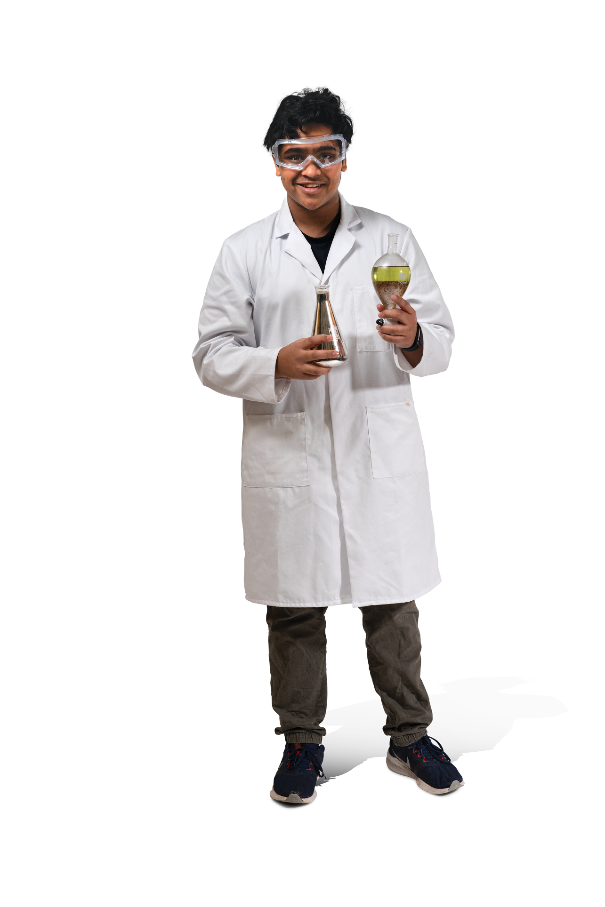
Choosing your subjects
Tips to help you make your choice
Don’t worry if you have not
yet decided what you want
to do in the future!
Y10 Taster Day is about the college experience – it’s OK to choose something just for fun
Choose any subject you like – whether it’s new to you or something you already love

Slide 6
A BROAD choice of subjects
A Levels |  |  | Vocational courses
Art | Film Studies | Music Technology | Applied Science
Biology | French | Photography | Applied Law
Business | Geography | Philosophy | Beauty Therapy/Hairdressing
Chemistry | German | Physical Education | Business
Classical Civilisation | Graphic Communication | Physics | Criminology
Computer Science | History | Politics | Digital Media
Dance | History of Art | Product Design | Education and Early Years
Drama and Theatre | Italian | Psychology | Fashion, Theatre Media Hair & Make-up
Economics | Law | Religious Studies | Health and Social Care
English Language | Mathematics | Sociology | Information Technology
English Language & Literature | Further Mathematics | Spanish | Performance: Acting
English Literature | Media | Textile Design | Popular Music Performance
Environmental Science | Music | Three-Dimensional Design | Sport

Slide 7
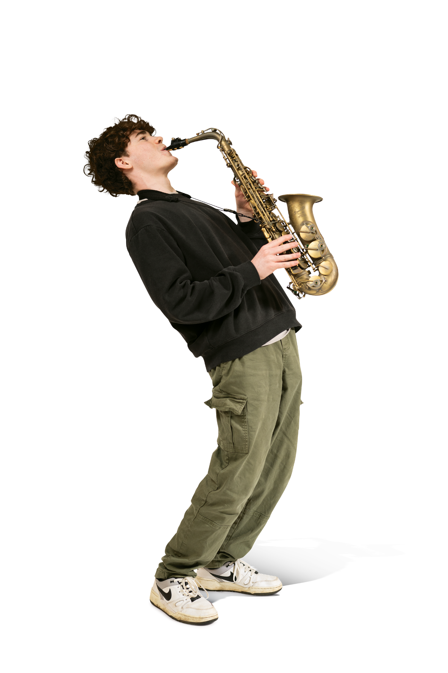
Timetable
You must arrive by 09:30am for registration
Time
09:30 – 09:55 | Registration and Welcome
10:00 – 10:50 | Subject 1
10:50 – 11:05 | Break
11:10 – 12:00 | Subject 2
12:05 – 12:55 | LUNCH or Subject 3
13:00-13:50 | Subject 3 or LUNCH
13:55 – 14:45 | Subject 4
Lunch and Subject 3 is staggered. This means you may have lunch break before Subject 3 or after Subject 3
You will have five minutes ‘movement time’ between sessions

Slide 8
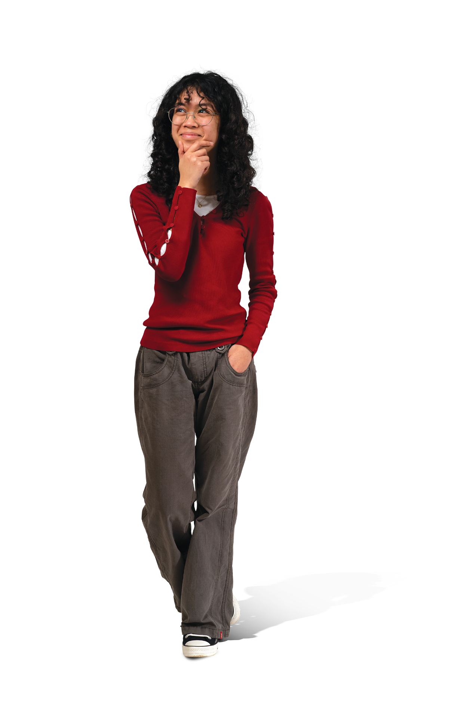
HOW TO SIGN UP
REGISTER ONLINE Today
You will need to set up an online account to register for the day and choose your subjects
www.psc.ac.uk/year10
Deadline:
Friday 13 march 2026
From your account, you will be able to view campus maps and your individual timetable

Slide 9
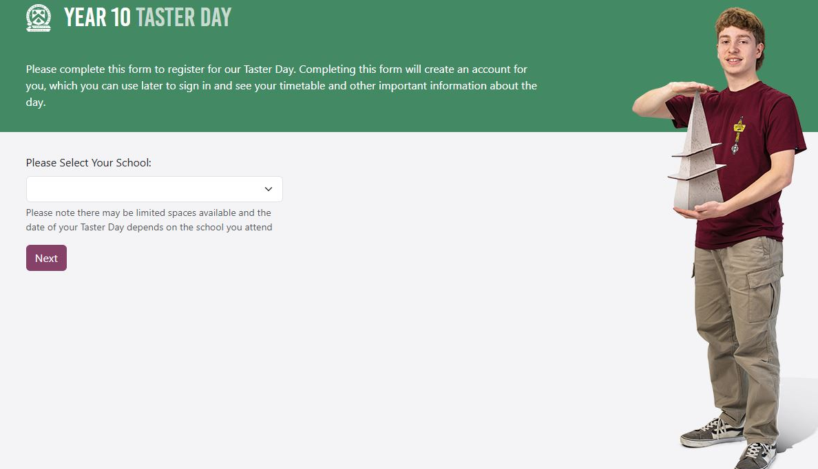
Registration
Firstly, we’ll need some basic details about you.
Start, by selecting your school.

Slide 10
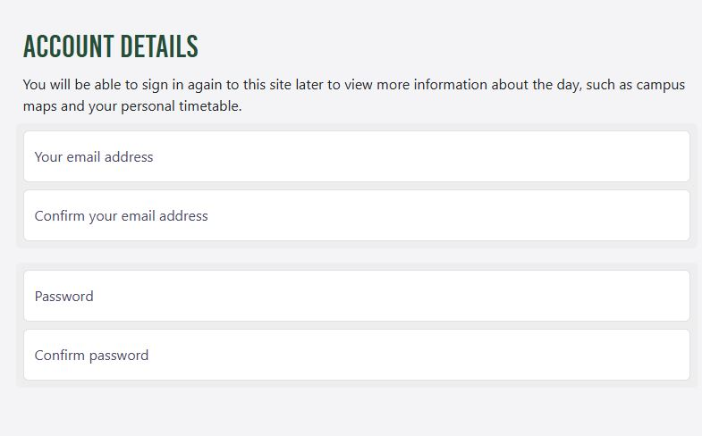
Registration
You can use your school email address to set up your Taster Day account.
By setting up your email and password, you will be able to access your Y10 Taster Day account to view the campus map and timetable (in June).

Slide 11
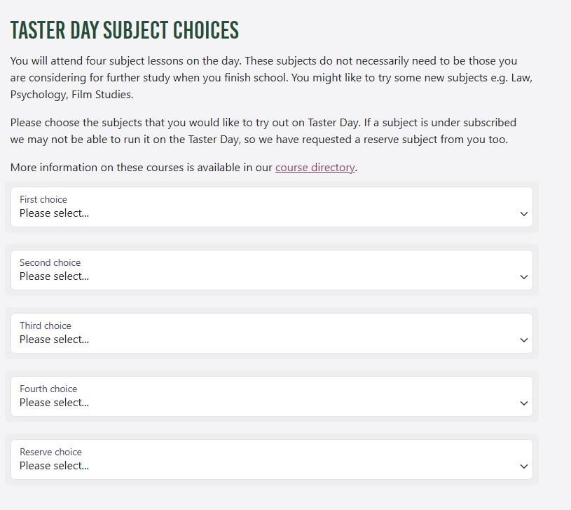
Registration
Now, for your course choices!
You will do four subjects and you can choose anything you like. If you are not sure, click on the course directory to see what is available.
REMEMBER
You will not be able to change your subject choices once you have completed your registration.

Slide 12
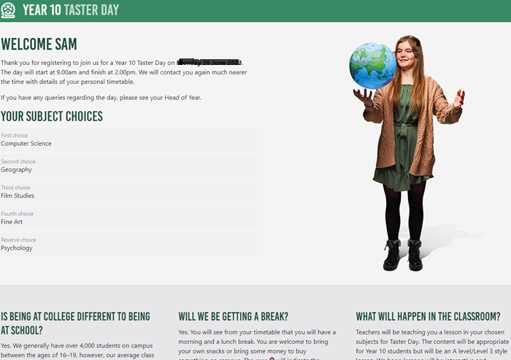
Registration Complete!
Once registered, you’ll be able to see your subject choices as well as information about what to expect on the day.

Slide 13
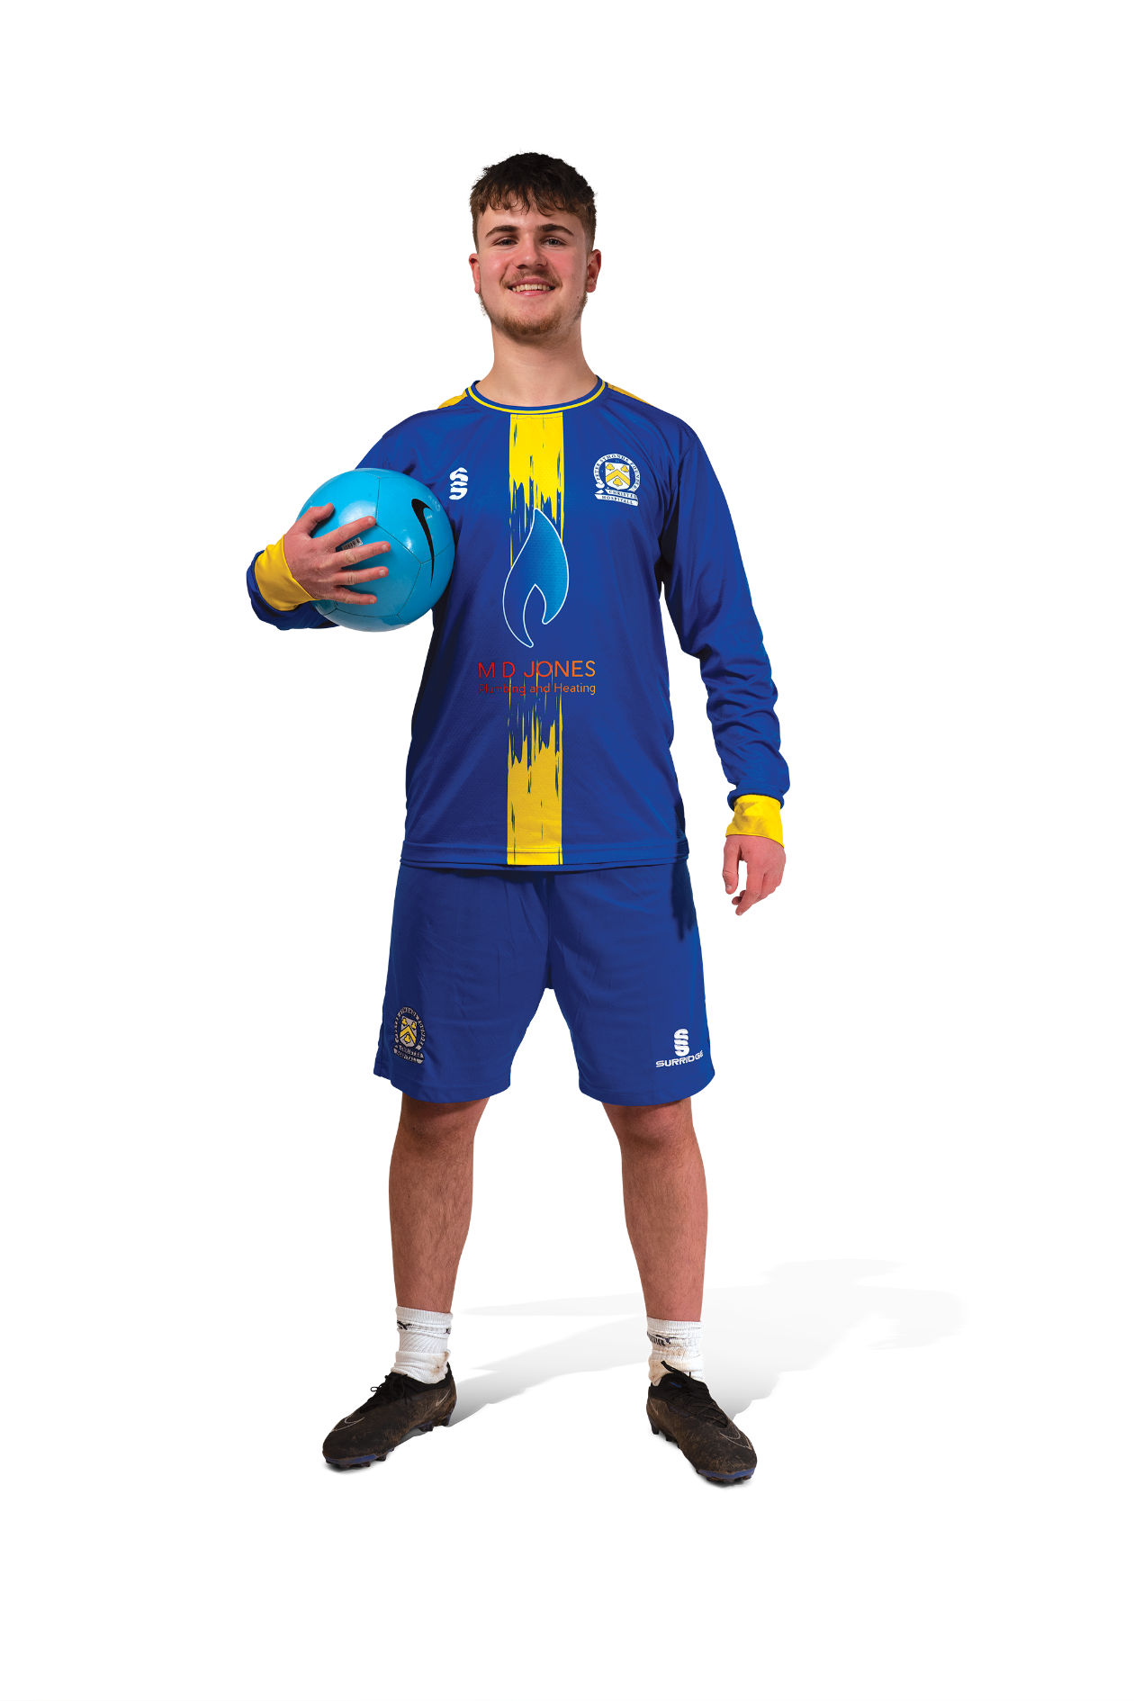
Our Expectations
What you need to know
Please arrive on time
Wear school uniform
Bring pen and paper
Attend all timetabled sessions
College is a mature learning environment,
we expect you to behave as young adults
Go to Reception if you have any issues
Do not leave campus grounds

